Slide 1

Assignment 1
Design and Analysis of Algorithm
IDAA432C
Largest and Smallest Pythagorean Numbers from a Randomly
Generated Array of Natural Numbers.
Submitted By:
Akshay Gupta (IIT2017505) Naman Deept (IIT2017507) Snigdha Dobhal (IIT2017506)
January 27, 2019

Slide 2
Abstract
This paper introduces several algorithms to find the largest and the smallest Pythagorean Numbers from the randomly generated array of Natural Numbers and then the most optimal approach to the problem is considered to efficiently solve the problem.

Slide 3
Pythagorean Number
A Natural number a is said to be a Pythagorean number if it can be written as sum of the square of two smaller Natural numbers b and c , such that ,
a² = b² + c²
If (a, b, c) is a Pythagorean triple, then so is (ka, kb, kc) for any positive integer k.
Any Pythagorean Number is a multiple of a Pythagorean prime (n) which is prime as well as of the form of 4n+1.

Slide 4
Proposed Method
Given 1000 randomly generated Natural numbers in an array , the aim is to find the largest and the smallest Pythagorean Number from this array of natural numbers ranging in between 10⁴ to 10⁶.

Slide 5
Naive approach
First method could be to check whether there exists any number i less than the given number n such that n² − i² is a perfect square . If such a number exists then the given number is a Pythagorean Number .

Slide 6
Algorithm:
1: procedure checkPythagorean(n)
2: for i ← 3 to n do
3: k ← √ (n ² − i ² )
4: l ← k ²
5: if l equals n ² − i ² then
6: return 1
7: end if
8: end for
9: return 0
10: end procedure

Slide 7
Time analysis
Best Case: For the best case of the algorithm we need to consider the smallest possible value in the range of the number ,and the value is 10⁴ which itself takes 6.10³ − 2 iterations. Consider the time taken for the single iteration to be x units. So the total time will be approximately t_{Ω} ∝(6.10³ − 2).x
and hence the complexity becomes overall closer to n.So the notation will be Ω(n) .
Average Case : In this case the complexity is Θ(n).
Worst Case : The worst case complexity can occur if
the number is not indeed a Pythagorean number. So
the complexity will be O(n).

Slide 8
Better Approach
A better method could be implementing Euclid’s formula which is a general formula for generating Pythagorean numbers, given any arbitrary pair of integers m and n where m > n > 0, if c² = a² + b² then
c = m² + n², b = 2mn, a = m² − n²
The triple generated by Euclid’s formula is primitive if and only if m and n are coprime and not both odd. When both m and n are odd, then a, b, and c will be even, and the triple will not be primitive; however, dividing a, b, and c by 2 will yield a primitive triple when m and n are coprime and both odd.

Slide 9
Algorithm
1: procedurecheckPythagorean(n)
2: for i ← 1 to √ n do
3: k ← √ (n ² − i ² )
4: l ← k ²
5: if l equals n ² − i ² then
6: return 1
7: end if
8: end for
9: return 0
10: end procedure

Slide 10
Time Analysis
Best Case: For the best case of the algorithm we need to consider the smallest possible value in the range of the number ,and the value is 10⁴ which itself takes only 60 iterations. Consider the time taken for the single iteration to be x units .So the total time will be approximately
t_{Ω} ∝ 60.x
and hence the complexity becomes overall closer to √ n which is 100.So the notation will be Ω(√ n) . Average Case : In this case the complexity is Θ(√ n). Worst Case : The worst case complexity can occur if the number is not indeed a Pythagorean number .So the complexity will be O(√ n).

Slide 11
Optimal Approach
We know that all Pythagorean number are multiples of Pythagorean prime which are prime number of the form of 4n + 1. Now to check whether the given number is Pythagorean number or not we can check if any of the prime factor of the given number is a Pythagorean prime or not .

Slide 12
Algorithm
1: procedure checkPythagorean(n)
2: while 2 divides n do
3: n ← n/2
4: end while
5: for i ← 3 to √ n in step of 2 do
6: if i divides n and 4 divides (n-1) then 7: return 1
8: end if
9: while i divides n do
10: n ← n/i
11: end while
12: end for
13: if n > 2 and 4 divides (n-1) then
14: return 1
15: end if
16: return 0
17: end procedure

Slide 13
Time Analysis
Best Case:Best case holds for the least possible time to be taken from the number in the given range.In our case consider the smallest number say 10⁴ in this case the complexity will be given as
t_{ω} ∝ log₂10⁴ + v
where v is a lesser quantity than log₂10⁴ .So the com- plexity is ω(log₂n).This complexity will hold perfect for the number which are perfect powers of 2 that is of the form 2^{n}.
Worst Case : The worst case complexity can occur if the number is not indeed a Pythagorean number. So the loop iteration will run for log2k + √ z times such that z = (n/2 k ). Out of both √ n is greater and so the time will heavily be determined by this factor.So the complexity here will be o( √ n) .

Slide 14
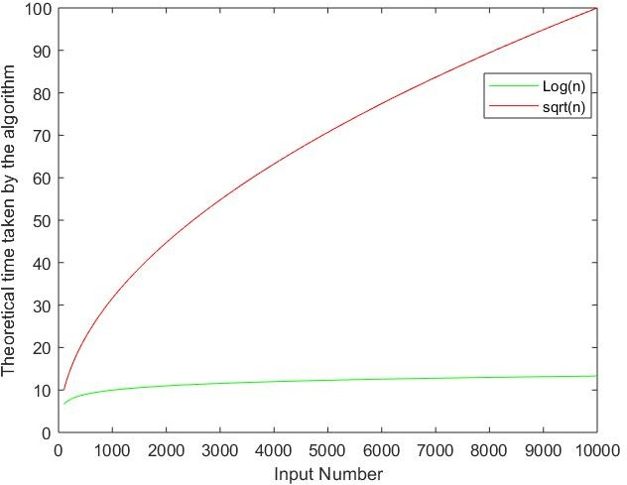
Time Analysis

Slide 15
Main Function
procedure Main
for i ← 0 to n do
if checkPythagorean(a[i])equals1 then
if min > a[i] then
min ← a[i]
end if
if max < a[i] then
max ← a[i]
end if
end if
end for
end procedure

Slide 16
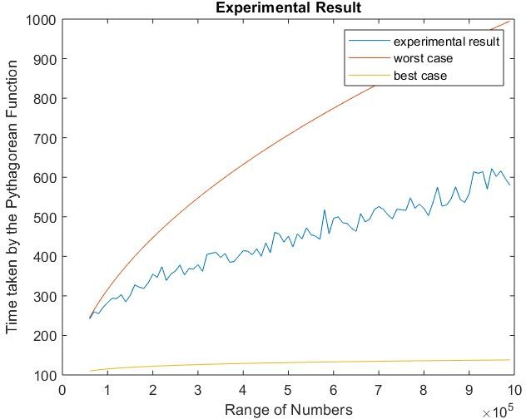
Experimental Results

Slide 17
Complexity Analysis and Explanation
The overall complexity in given problem turns out to be O(k.√ n/2 + k. log(n)) where k denotes the length of the array. The plot for the graph can be explained as follows: Consider a value from the randomly generated numbers if it is of the form of 2n.p where p is prime, Then the time taken in this case will be k.(n + √p/2) which will be the worst case situation and the best case will be k.log2n provided the loop terminates in the while block itself. Hence the overall complexity in the situation will lie in between those two values, that is
k. log n < t_{avg} < k. √n + k.p
where k is the length of the array.

Slide 18
Discussion and Future Work
We have used the fact that all the Pythagorean numbers are multiples of Pythagorean prime , so we only checked if the smallest Pythagorean prime divides the given number . Other way could be , as we have been given array ranging from 10⁴ to 10⁶ , the largest prime factor of such number will be less than 10³ if such a number is not prime else we need to check the given number is prime and of the form 4n+1 . We can store all the Pythagorean primes less than 10⁶ in an array, and check the given number if divisible by any Pythagorean prime stored in this array . Only 80 such primes exist under 10³ , so a lot of computations will be minimized . Also one could use sieve method to save all the Pythagorean primes and then use the same method to check if the number is Pythagorean number or not .

Slide 19
Conclusion
We analyzed various algorithms to find the largest and the smallest Pythagorean number and developed optimal approach to find the desired number from the randomly generated array of numbers . We also analyzed how Pythagorean prime factors were related to the problem . However , pre-computation of the problem to generate Pythagorean primes or with sieve method , the given problem may be more efficient if memory-time complexity trade-off is considered in favor of memory.

Slide 20
References:
IDAA432C (Design and Analysis of Algorithm) class lecture
2. Pythagorean triples reference -
https://en.wikipedia.org/wiki/Pythagorean_{t}riple
3. Euclid’s formula reference
http://demonstrations.wolfram.com/EuclidsFormula AndPropertiesOf PythagoreanTriples/
4. Introduction to Algorithms by Cormen

